Slide 1
Bot Framework and Cognitive Services
Vince Paulson
Senior Consultant, Solution Architect
HMB
Notes:
Name is Vince Paulson
Senior Consultant at HMB
Introduce you to Azure Bot Framework and Cognitive Services
Been with HMB for over 2 years
Software Development for 11 years

Slide 2

23 years
Notes:
HMB is a technology firm that has been in business for 23 years. We offer experienced teams the ability to develop custom software solutions that help our clients solve their business challenges. We have helped hundreds of companies achieve their goals by using reliable, newer, and scalable technologies to implement effective applications that support and complement their core business functions. HMB is committed to training and career growth (look up our HMB University), and on a daily basis teams collaborate to deliver awesome project solutions! Most of all… we have fun and have a life outside of work!

Slide 3
Bot Framework
https://dev.botframework.com/

Slide 4
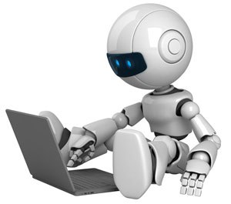
Overview
The Microsoft Bot Framework is a comprehensive offering that you use to build and deploy high quality bots
Introduced April 2016
Components
Bot Builder SDK
Bot Connector
Developer Portal
Bot Directory
Emulator

Slide 5
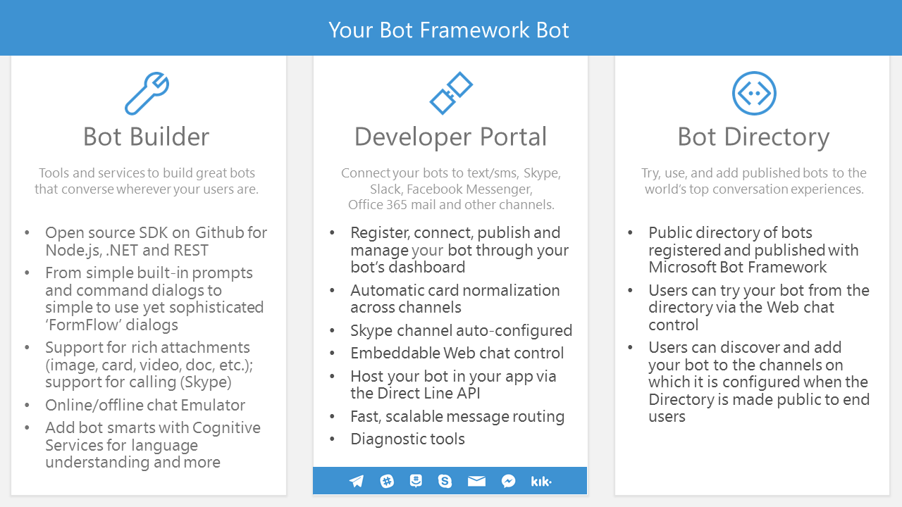

Slide 6
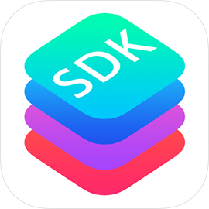
Bot Builder SDK
https://github.com/Microsoft/BotBuilder
https://github.com/Microsoft/BotBuilder-Samples/tree/master/CSharp

Slide 7

Bot Connector
Provides API for communication across multiple services such as Skype, Facebook, Email, Slack, etc.
https://docs.botframework.com/en-us/csharp/builder/sdkreference/connector.html

Slide 8

Developer Portal
https://dev.botframework.com/bots

Slide 9
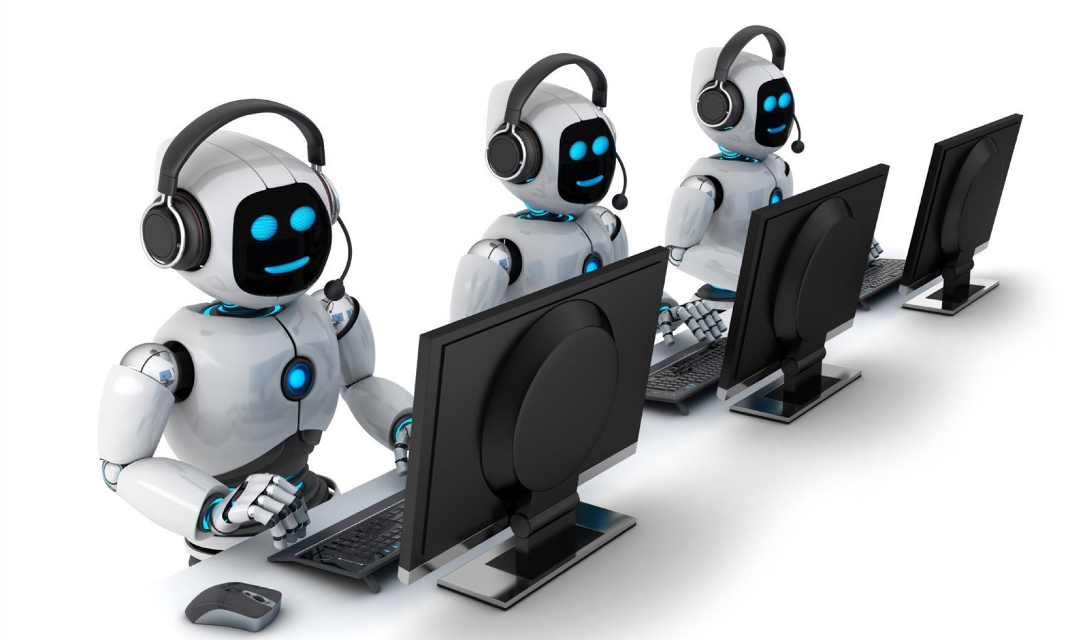
Bot Directory
Directory of existing bots
https://bots.botframework.com/

Slide 10
Bot Emulator
https://docs.botframework.com/en-us/tools/bot-framework-emulator/

Slide 11
Cognitive Services
https://www.microsoft.com/cognitive-services/en-us/apis

Slide 12
Overview
Microsoft Cognitive Services (formerly Project Oxford) are a set of APIs, SDKs and services available to developers to make their applications more intelligent, engaging and discoverable
Several categories:
Vision
Speech
Language
Knowledge
Search

Slide 13
Demo
Woo!

Slide 14
Resources
https://docs.botframework.com/en-us/
https://github.com/Microsoft/botbuilder
https://docs.microsoft.com/en-us/azure/cognitive-services/
https://blogs.msdn.microsoft.com/smich/2016/09/30/microsoft-bot-framework-resources/
https://github.com/sagefranch/botdemo

Slide 15
The END
QUESTIONS?

